Slide 1

Gokaraju Rangaraju Institute Of Engineering and Science
Dept : Computer Science
Life Saver Project(Blood Donation System)

Slide 2
Batch Members
Supervisor
Supervisor : G.N.BeenaBethel
Designation : Associate Professor
Batch no:B7
1.Venkatesh Kadali 12241A0559
2.Ramkumar Bhukya 12241A0567
3.Swarup 13245A0519
4.Sairam 11211A0579

Slide 3
Contents :
1. Abstract 2. Introduction 3. Existing System 4. Proposed System 5. Software Requirements 6. Hardware Requirements

Slide 4
Introduction
Life saver system is a web application developed for blood donations.
This consists of two set of users, Administrators and Blood Donors. Administrator login is created for chief doctors in major hospitals which run this web application.
Blood Donors who are willing to donate blood have to register in the system.

Slide 5
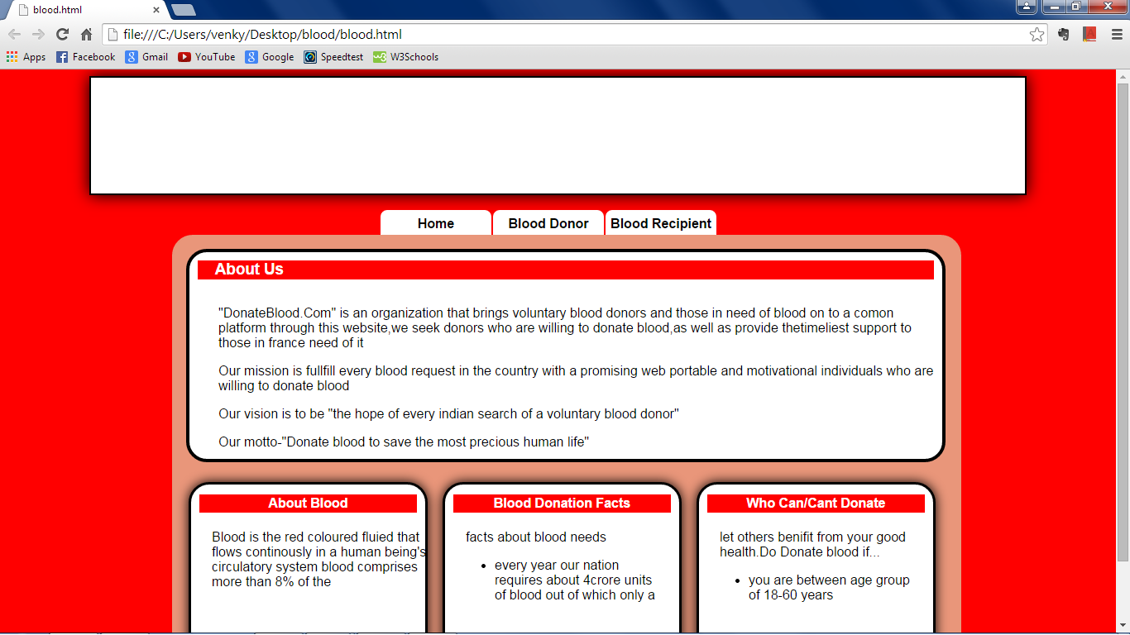

Slide 6
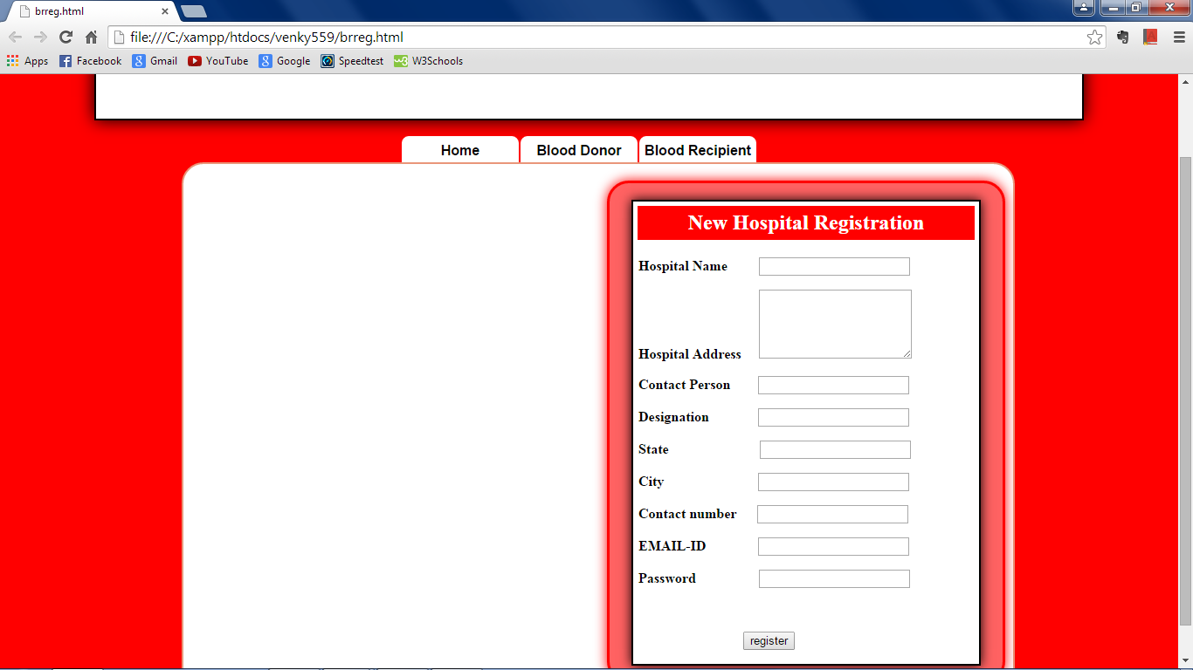

Slide 7
Abstract :
When blood is needed for a person, then the corresponding administrator should add the details of the patient such as, Patient name, Blood group, Location of the hospital, etc.
The system will automatically analyze the list of donors who can donate blood for a particular patient.
Then the system compares the location of the person and the hospital where the patient is admitted. Then the system compares the day of blood needed and the day’s availability of the donor.

Slide 8
Finally for the qualified donors E-Mail will be sent to their personal Mail Address and a mail will be dispatched to the donor login page of the system.
If the donor is interested in donating blood then he can login to the system to see the full details.
Several donors may be interested in donating blood and it may create confusions. So, once a donor reaches a hospital for blood donation. It should be updated in the system.
Then the system will automatically send E-Mail to all the remaining donors that their need is fulfilled.

Slide 9
Existing System
Due to the increased demand of the blood ,that hospitals are dependent on a constant supply of blood.
Recent figures provided by the World Health Organisation (WHO) states that India faces a shortage of 3million units of blood per year.
There are some websites related to Blood Donation. But in those websites the recipient should call all the donors who are listed in that website.

Slide 10
Proposed System :
In Life saver system ,the recipient need not call to all the blood donors. The system will automatically send the messages to all the donors.
So the donors who are willing to donate the blood can go to the corresponding hospital.
Once a blood donor reaches to the hospital to donate the blood. Then the system will automatically send E-Mail to all the remaining donors that their need is fulfilled.

Slide 11
Hardware Requirements :
Processor : Pentium 1V
Speed : 2.0GHz or more
Memory : 256MB RAM or more
Hard Disk Drive: 40GB or more

Slide 12
Software Requirements :
Platform : Any(Windows , Linux or Android)
Languages Used : CSS , JAVASCRIPT , PHP , HTML
Database Used : XAMPP SERVER , MYSQL
Other : Web browser(Chrome , Mozilla Firefox)

Slide 13
References
W3Schools(HTML) : http://www.w3schools.com/html/default.asp
W3Schools(CSS) :
http://www.w3schools.com/css/default.asp

Slide 14


